Slide 1

Lecture 7
Passport

Slide 2

Agenda
Authentication & Authorization
What is Passport.js?
The Node.js Authorization flow
Summary

Slide 3

What is authorization?
Authorization is restricting access to certain areas of the application for a user when the user’s identity is already known to the server.
For example, the server might know that jake@example.com is logged in, therefore jake shall be allowed to access his orders, while linda@anotherwebsite.com is an admin and she shall be able to see everyone’s orders and the financial records, while Jake shall not be allowed to.
Authorization is typically implemented by guard middleware, which make sure that when the user makes the request, they have enough permission to actually be able to call that route or execute that method.

Slide 4
Authentication vs Authorization
Often when building out our APIs we want to restrict access to certain regions of the API to a certain area, sometimes it’s just that we need to know which user is logged in and other times we also want to give permissioned access to certain areas, for example only staff users with manager level access shall be allowed to access
Authentication
Authorization
Authentication is the process of verifying someone is who they are claiming to be, for example, someone saying that they are “john@doe.com” and want to access the application, then they will need to provide their information for verification. If they are verified, we said the user is authenticated and we allow the user to access the application. An example is user login, a user want to login to access an application, he/she will need to first verify their identity with their credentials.
Authorization is the process of verifying if someone has access to an area of the application when their identity is already known to the server and the API checks for the access a user shall have, for example a staff user on an e-commerce platform shall be allowed to access the financial details and the order details of every single order placed on the website. While a regular user shall only be able to see their orders and browse the product catalog.

Slide 5
What is Passport.js?
Passport.js is a simple, unobtrusive Node.js authentication middleware for Node.js.
Passport.js can be dropped into any Express.js-based web application.
Install passport-local using npm.

Slide 6
The Node.js Authentication Flow
Our goal is to implement the following authentication flow into our application using Passport.js:
User enters username and password
The application checks if they are matching
If they are matching, it sends a Set-Cookie header that will be used to authenticate further pages
When the user visits pages from the same domain, the previously set cookie will be added to all the requests
Authenticate restricted pages with this cookie

Slide 7
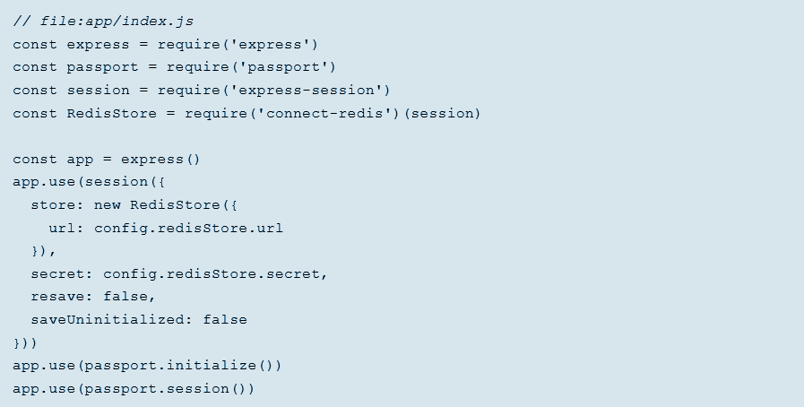
Step 1: Setting up Express
First of all, we required all the dependencies that the session management needs. After that we have created a new instance from the express-session module, which will store our sessions.
For the backing store, we are using Redis, but you can use any other, like MySQL or MongoDB.

Slide 8
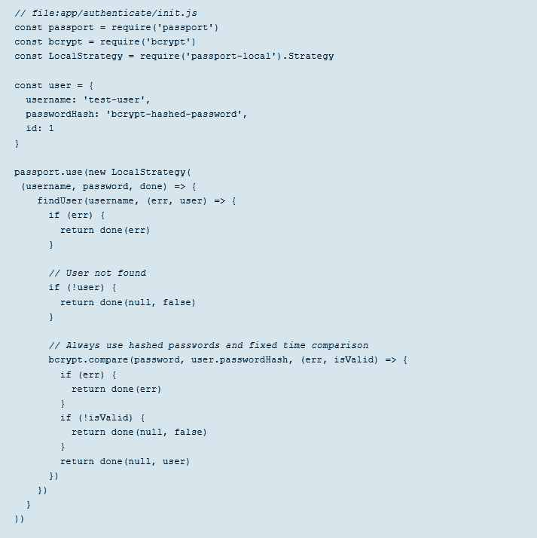
Step 2: Setting up Passport.js for Node.js
In this passport.js tutorial, we are adding the passport-local module which enables easy integration of a simple local authentication strategy using usernames and passwords.
For the sake of simplicity, in this Passport.js example, we are not using a second backing store, but only an in-memory user instance. In real life applications, the findUser would look up a user in a database.
Once the findUser returns with our user object the only thing left is to compare the user’s hashed password and the real password to see if there is a match. Always store passwords hashed and use fixed time comparison to avoid timing attacks.﻿
If it is a match, we let the user in (by returning the user to passport – return done(null, user)), if not we return an unauthorized error (by returning nothing to passport – return done(null)).

Slide 9


Step 3: Adding Protected Endpoints
To add protected endpoints, we are leveraging the middleware pattern Express uses. For that, let’s create the authentication middleware first:
It only has only one role if the user is authenticated (has the right cookies); it simply calls the next middleware. Otherwise it redirects to the page where the user can log in.
Using it is as easy as adding a new middleware to the route definition.:

Slide 10
Summary
Understand the difference of Authentication vs Authorization. (If you want to know more technical knowledge on Authentication and Authorization, check out the reading material on the Authentication vs Authorization tutorial slides)
Passport is authentication middleware for Node.js.
Extremely flexible and modular, Passport can be unobtrusively dropped in to any Express-based web application.

